Slide 1


Challenges in Estonian integration policy from the perspective of the migration crisis
Piret Hartman
Undersecretary for Cultural Diversity

Slide 2
BACKROUND
OUR TARGET GROUP
COORDINATION OF THE INTEGRATION POLICY IN ESTONIA
INTEGRATION POLICY GOVERNANCE
COHESIVE ESTONIA 2030 DEVELOPMENT PLAN

Slide 3
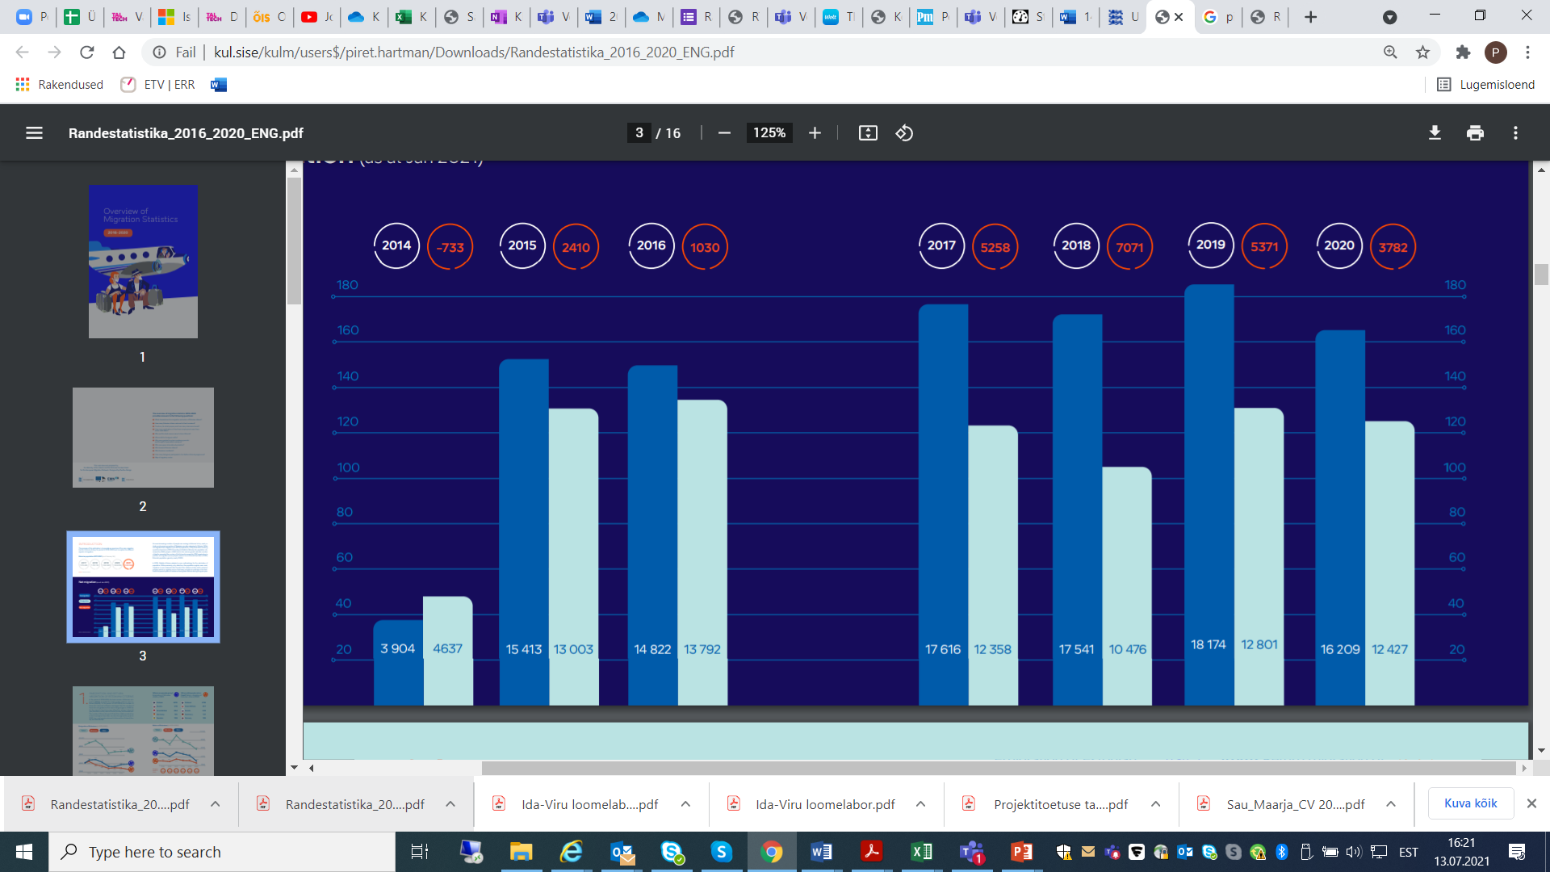
BACKROUND
200 different nationalities
1/3 of our population is made up of people of other ethnic origin.
85% of people in Estonia have Estonian citizenship.
Undetermined citizenship is 6% of our population.

Slide 4
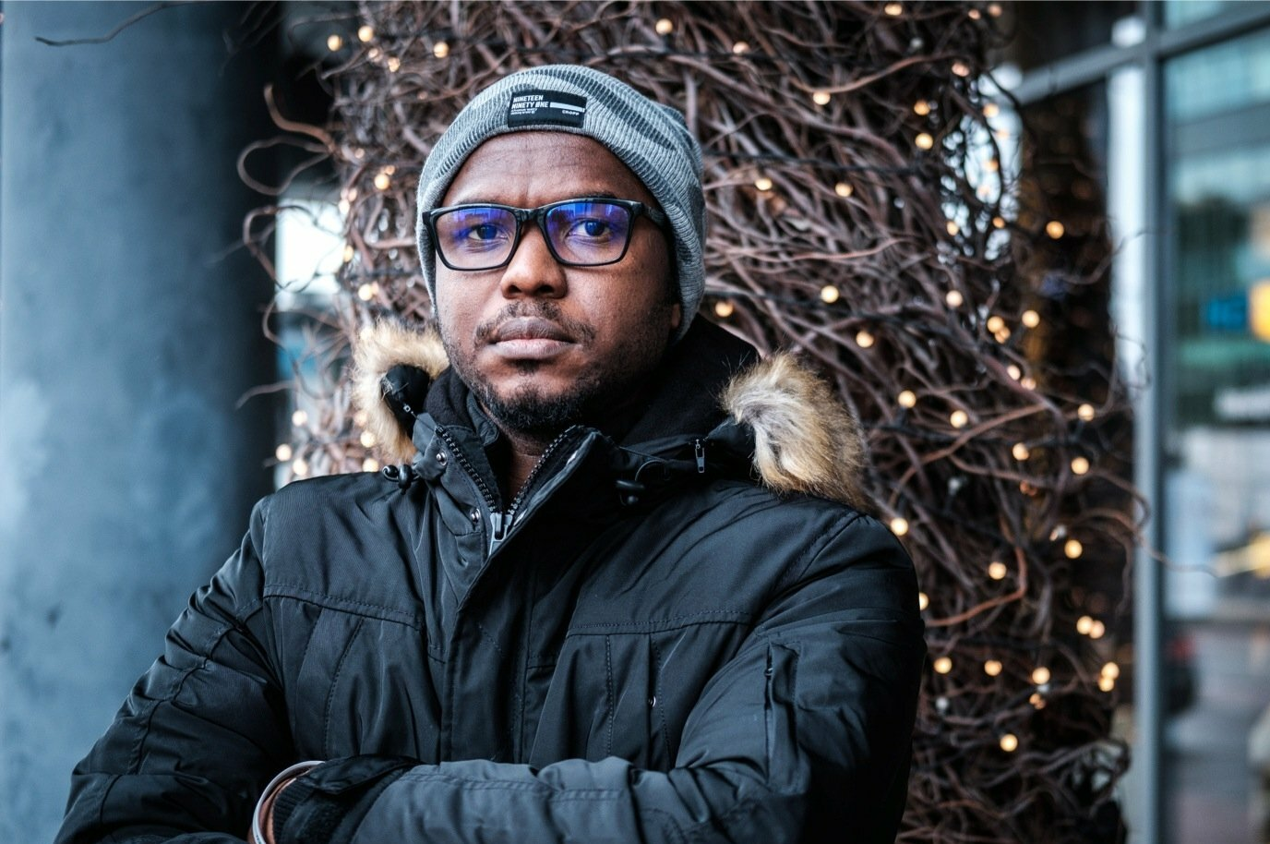
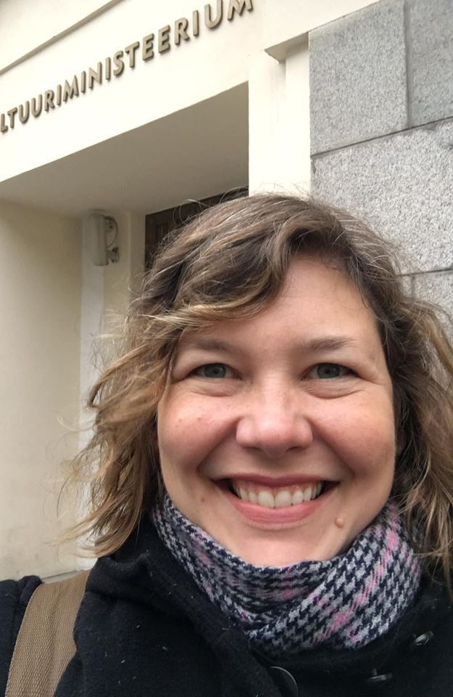
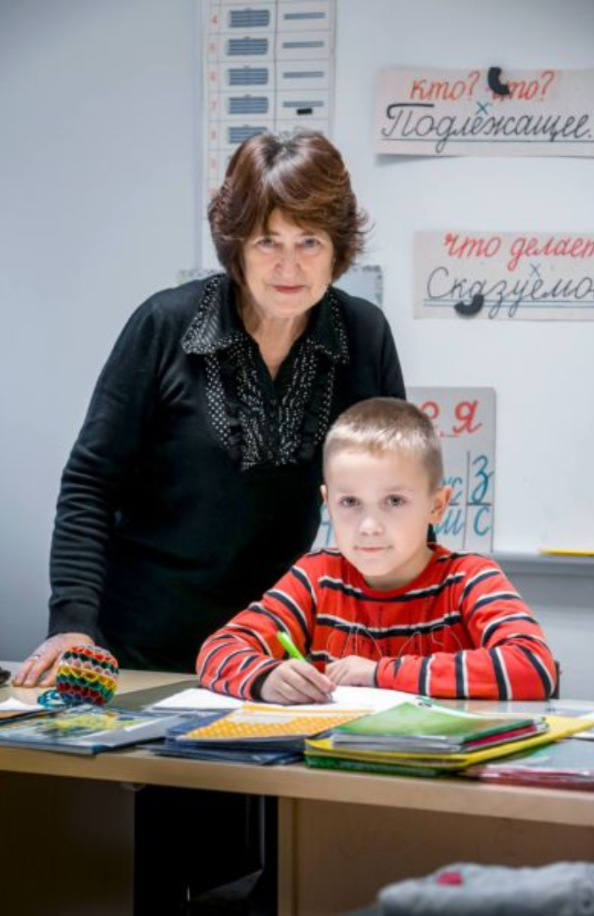
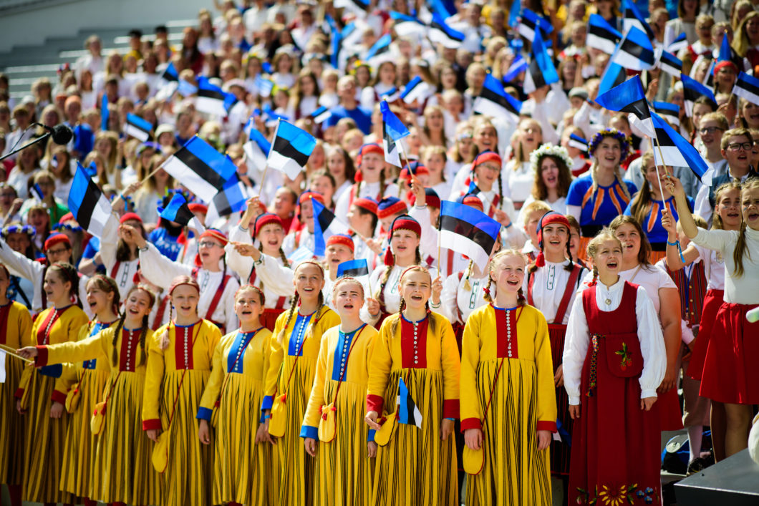
OUR TARGET GROUP
Notes:
RUSSIAN CHILD
education system does not support communication and cooperation of Estonian children and children of other nationalities;
insufficient Estonian proficiency of students at the end of basic and vocational education;
RUSSIAN CHILDS’ PARENTS AND FRIENDS
socio-economic gaps (language proficiency, age, and health)
gender and nationality based segregation in the labor market (wage gap, unemployment and employment)
regional ethnic segregation in Ida-Viru and Harju
individuals do not speak Estonian in their daily lives due to limited language environment or because language courses don’t develop communication skills;
individuals of other nationalities distrust state institutions less;
lower participation in cultural life among individuals of other nationalities;
lower participation in voluntary activities and non-governmental organization among individuals of other nationalities;
NEW IMMIGRANT AND RETURNER
insufficiency of adaptation services;
individuals do not speak Estonian in their daily lives due to limited language environment or because language courses don’t develop communication skills;
regional ethnic segregation in Ida-Viru and Harju
ESTONIANS, NGOS AND MUNICIPALITIES
insufficient development of an information field shared by Estonians and individuals of other nationalities;
Estonians’ scant readiness for integration as well as lack of strategic communication in this field;
municipalities and NGOs have limited knowledge and capability to support adaptation and integration of target groups.

Slide 5
COORDINATION OF THE INTEGRATION POLICY IN ESTONIA
Ministry of Culture
Ministry of Social Affairs
Ministry of Education and Research
Ministry of the Interior
Ministry of Justice
Integra-tion Fondation
Local Govenr-ments
Social partners

Slide 6
INTEGRATION POLICY GOVERNANCE
LABOUR MARKET
EDUCATION
LABOUR MARKET
EDUCATION
MEDIA
INTEGRATION
HEALTHCARE
Integration
HEALTHCARE
MEDIA
Growth of migration
in Estonia
Readiness and awareness of partners
Provision of adoptation and integration services
Notes:
Substantive goals

Slide 7

COHESIVE ESTONIA 2030 DEVELOPMENT PLAN
Prepared cooperatively by three ministries
Deals with four areas of activity
Ministry of Culture
Ministry of the Interior
Ministry of Foreign Affairs
Adaptation and integration policy (responsible: MofC)
Civil society policy (responsible: MofI)
Population procedures (responsible: MofI)
Global Estonianness (responsible: MofFM)

Slide 8

MAIN OBJECTIVE OF THE DEVELOPMENT PLAN
Estonia is a sustainable nation-state where everyone can have a prosper life.
The people of Estonia are cooperative, share a common Estonian cultural space, value the Estonian state and feel togetherness, regardless of their mother tongue, cultural background, or place of residence.
In a diverse Estonia, everyone shares democratic values and a common Estonian identity.
The activities of the state are people-centered and support development of communities. Everyone feels valued and involved.
People want to connect their lives with Estonia by actively participating in the community life, social life, and development of the country - they are offered various opportunities while living in Estonia or abroad.
“Estonia is a cohesive and inclusive society”

Slide 9
ESTONIA SUPPORTING ADAPTATION AND INTEGRATION: Courses of action
Supporting the local level and developing cross-sectoral partnerships
Promoting social contacts that support a sense of togetherness
Developing modern, smart and effective adaptation and integration paths
Supporting an innovative and responsible labour market
Creating a common, understandable and reliable communication and information space
Improving Estonian language skills, as well as the connection with the state and cultural space

Slide 10
Thank you!
Piret Hartman
piret.hartman@kul.ee

