Slide 1
“Get the political parties out of the universities"
Greek universities as contested political spaces
Dr Ioannis V Papageorgiou
Research Director at Rhodes Centre for History and Social Research 22.10.2021

Slide 2
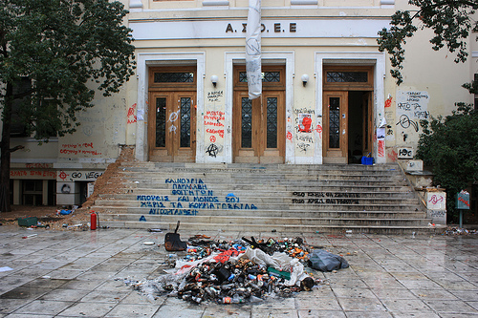
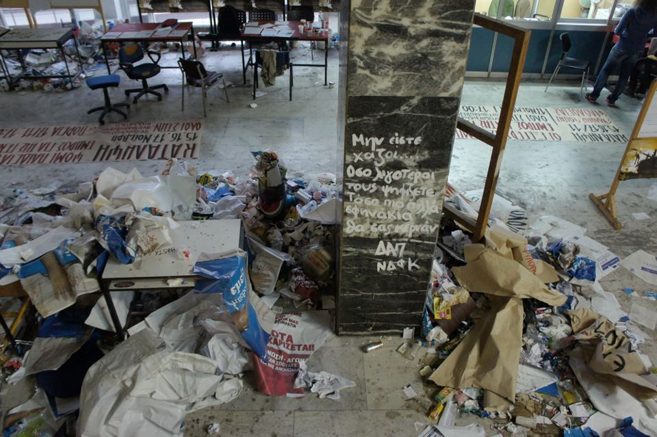
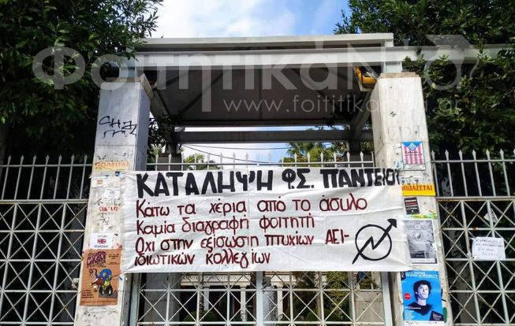

Slide 3
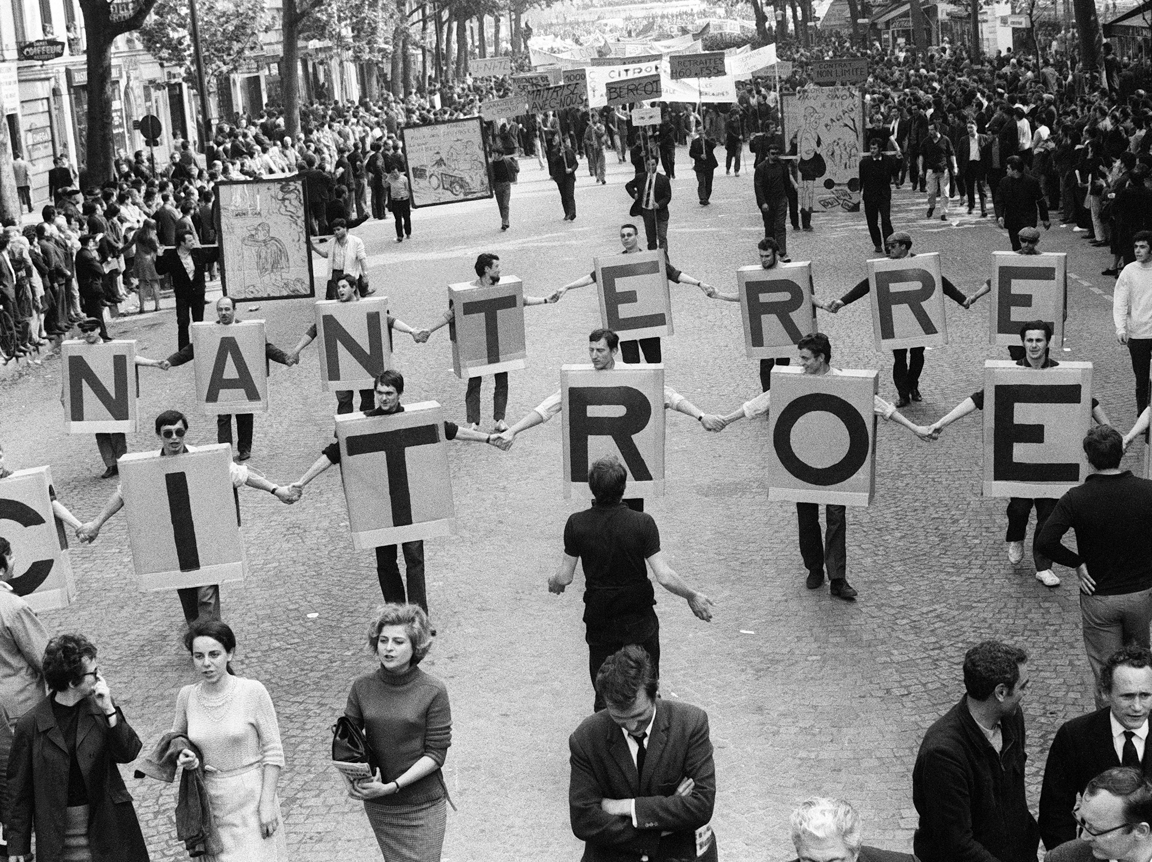
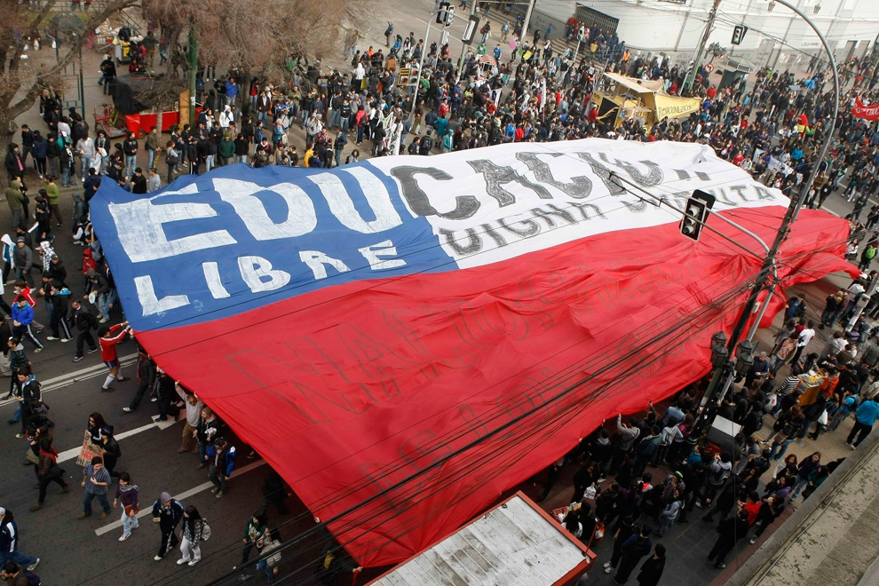

Slide 4
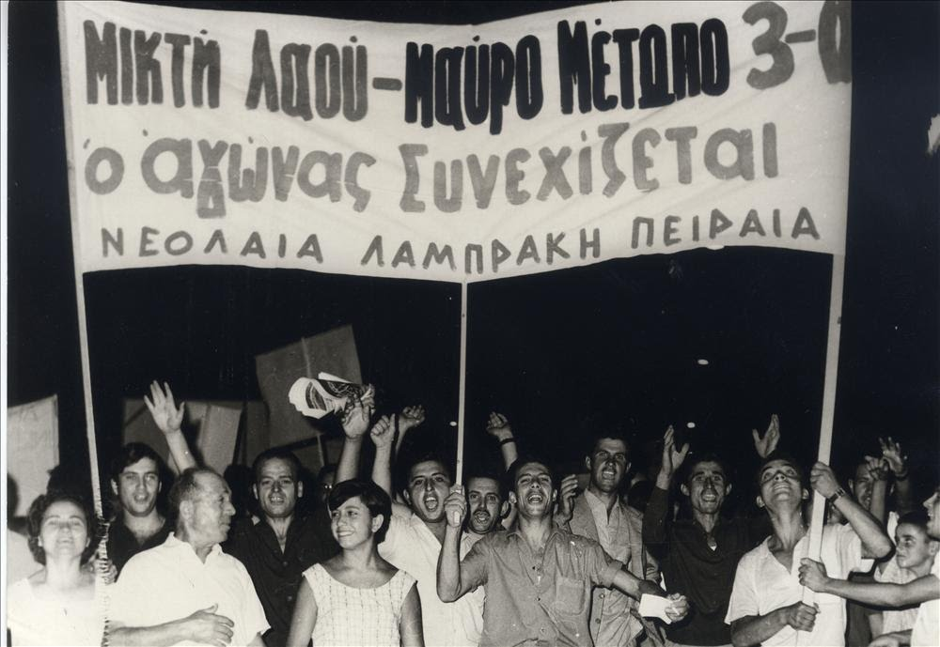
The Political role of Universities in Greece
Established in the political subconscious
Part of the dominant political narrative
Institutionalised practice

Slide 5
The Political role of Universities in Greece
Minimal interruption due to political action
“Friction” inherent in politics
Selective sensitivity
Politics and/or parties: a symbiotic relationship
Parties: necessary mediators articulating interests
Individual representatives reduced to monothematic proponents
Universities do not exist in a political vacuum

