Slide 1
INTEGRATION STORIES
Gunta Vīksne
Society SHELTER SAFE HOUSE Latvia
March 2022

Slide 3
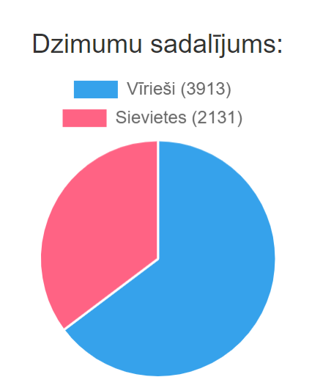
OUR CLIENTS

Slide 4
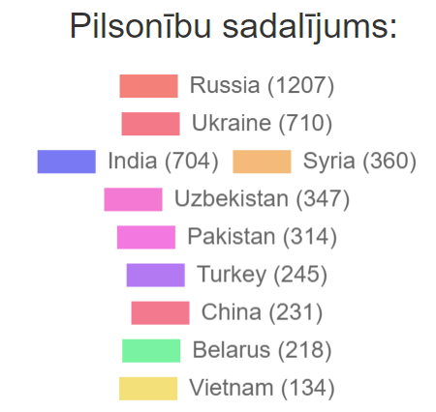
OUR CLIENTS

Slide 5
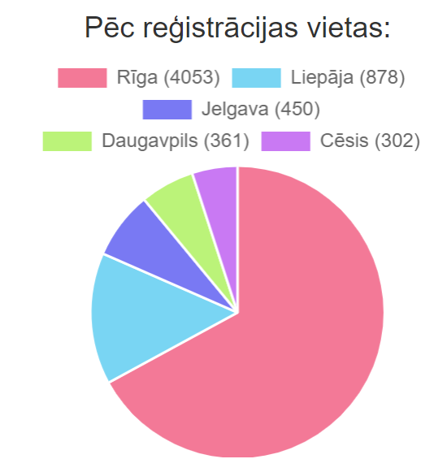
OUR CLIENTS

Slide 6
OUR CLIENTS

Slide 7
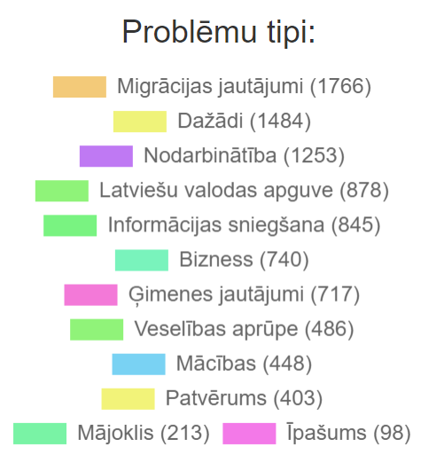
OUR CLIENTS

Slide 8
OUR CLIENTS

Slide 9
THANK YOU!

