Slide 1
INFORMATION
CENTRE FOR NEWCOMERS!
Inlcusion resource for life in Latvia
Notes:
To use this title animation slide with a new image simply 1) move the top semi-transparent shape to the side, 2) delete placeholder image, 3) click on the picture icon to add a new picture, 4) Move semi-transparent shape back to original position, 5) Update text on slide.

Slide 2
Society SHELTER SAFE HOUSE
Our mission
A safe home for different people
Society “Shelter “Safe House”” was established on August 6, 2007 with the aim to develop support services to victims of human trafficking, legal immigrants, including asylum seekers, refugees and persons granted subsidiary protection status
Our values Communication
Challenge
Belonging

Slide 3
!
INFORMATION CENTRE FOR NEWCOMERS
Since May 18, 2016, the Information Center for Newcomers has been operating as a one-stop agency throughout Latvia (Riga, Vidzeme, Latgale, Zemgale, Kurzeme).)
Currently the project is in its 3rd cycle, which started in July 2020 and running up until December 2022.
ICN aims to give the sense of security to all legal migrants , the sense that they are being needed and welcomed in Latvia by defending their rights, needs and interests.

Slide 4
!
INFORMATION CENTRE FOR NEWCOMERS
Our target group
A third-country national - person who is not a citizen of the member states of the European Union, the European Economic Area or the Swiss Confederation.
State, municipality and private institutions, NGO’s, entrepreneurs
Free consultations on:
Employment Migration Rights of tenants Family law Starting a business Legalization and recognition of education documents
Translation services
15+ different languages for verbal or written translation free of charge

Slide 5
!
INFORMATION CENTRE FOR NEWCOMERS
Integration activities
Non-formal education activities Volunteer initiatives Development of NGO cooperation network
Psychologist consultations
Support for both children and adults upon request.
Dialogue platform
A place for the representatives of state institutions, municipalities, NGO’s and private institutions, including entrepreneurs to meet and discuss hottest migration topics in Latvia and worldwide.

Slide 6
!
INFORMATION CENTRE FOR NEWCOMERS
Communication activities
Audio and video podcasts Social media publications Updates about integration activities in Latvia for migrants and general public
Trainings for specialists
Integration workers State and municipality representatives Translators

Slide 7
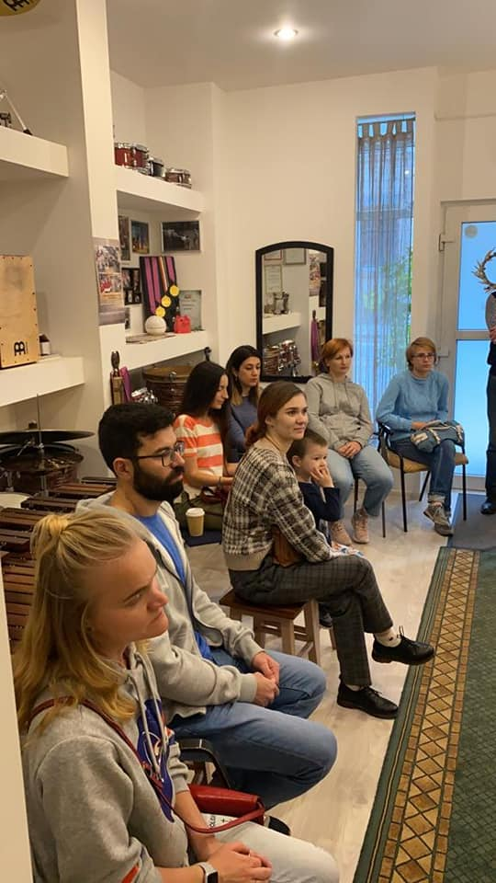
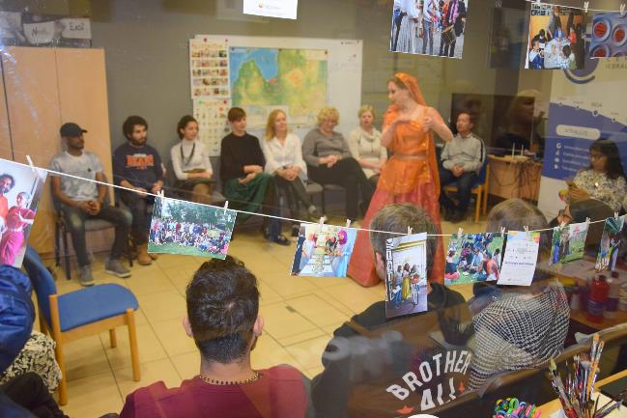
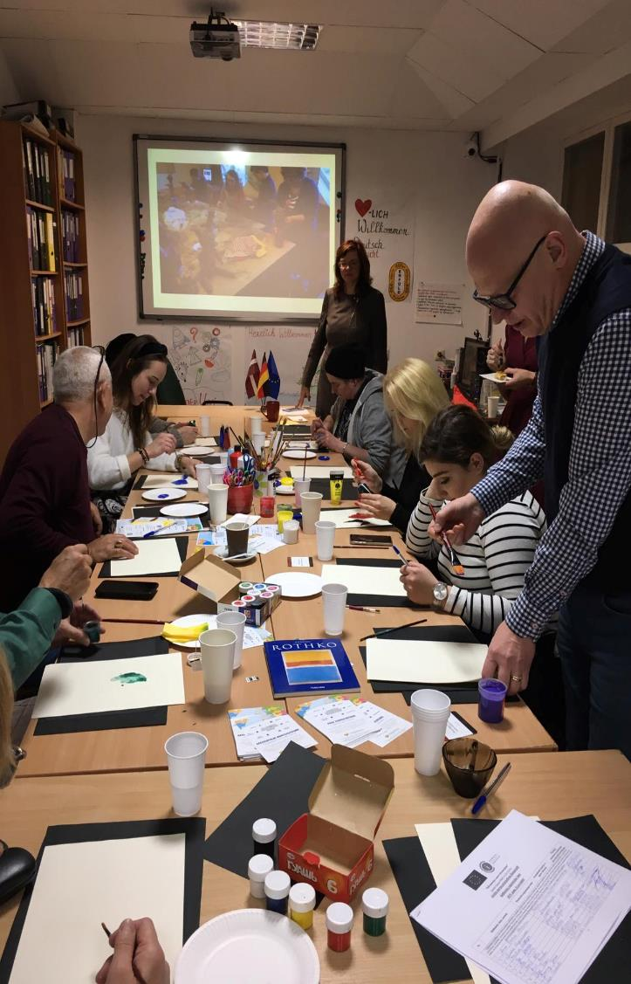
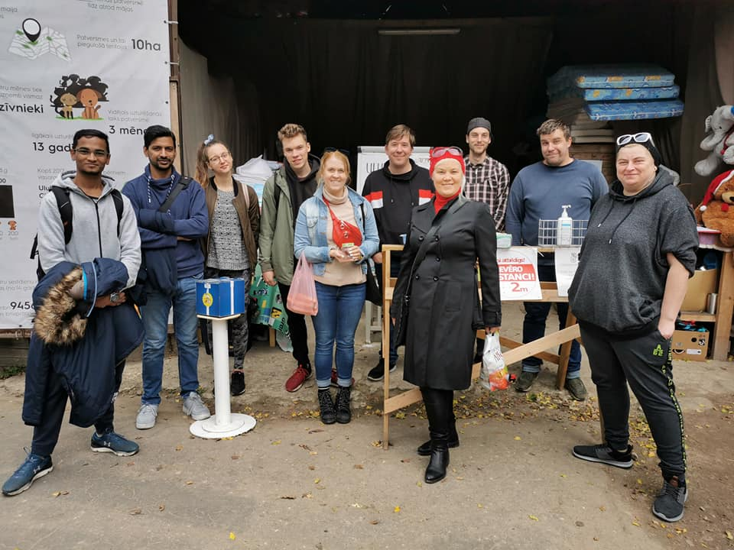
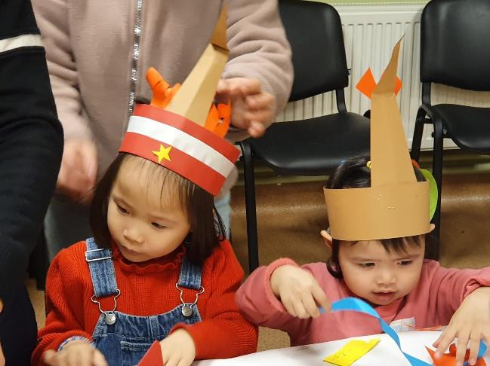

Slide 8
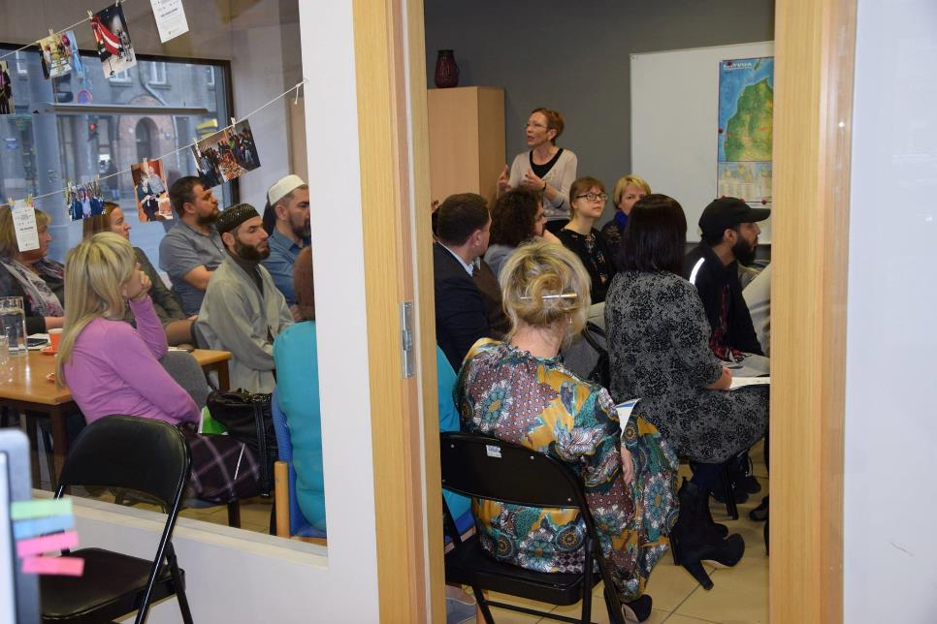
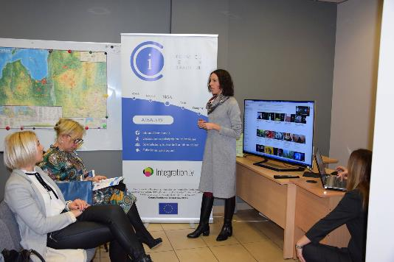
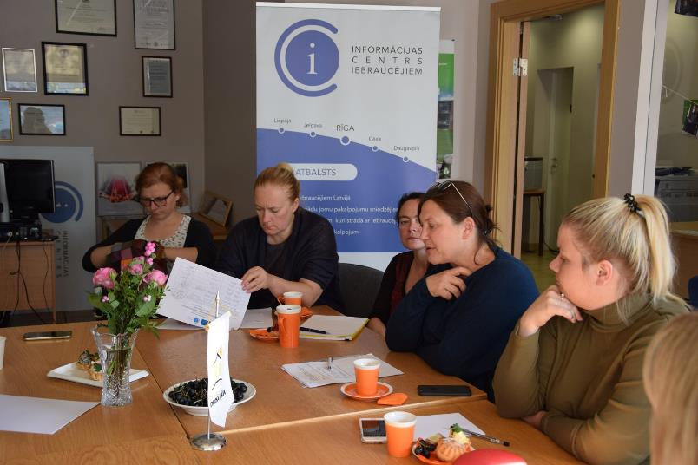
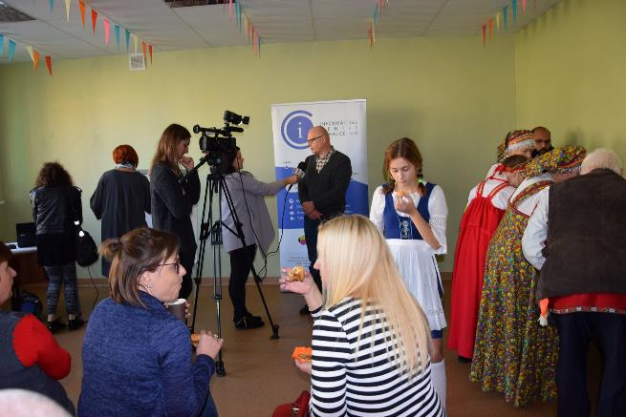
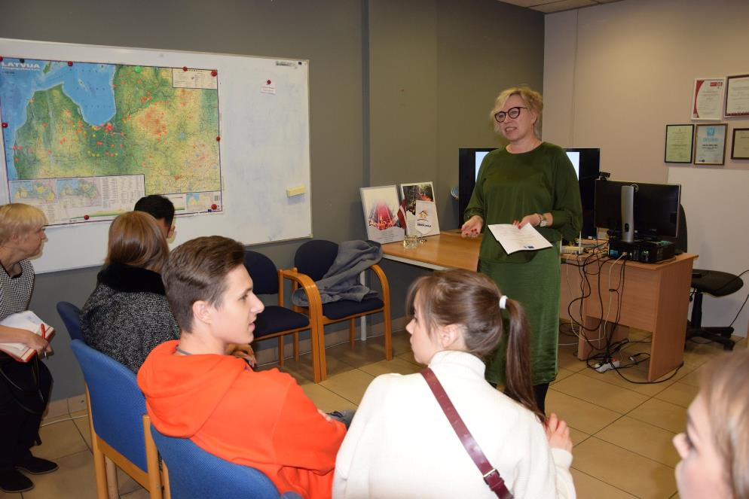
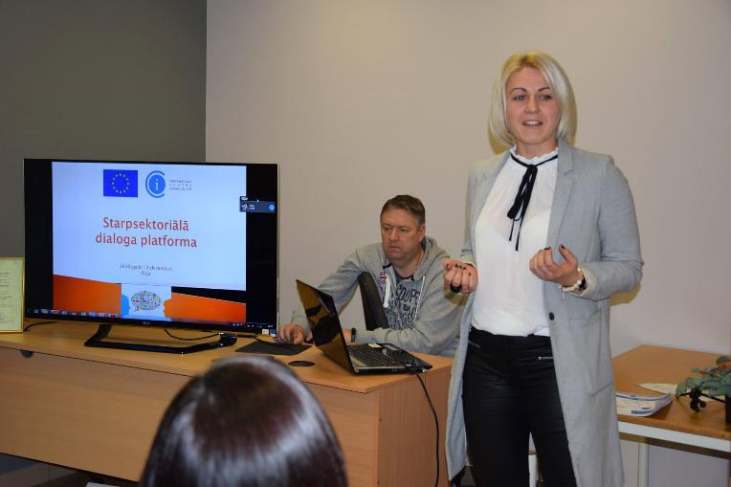
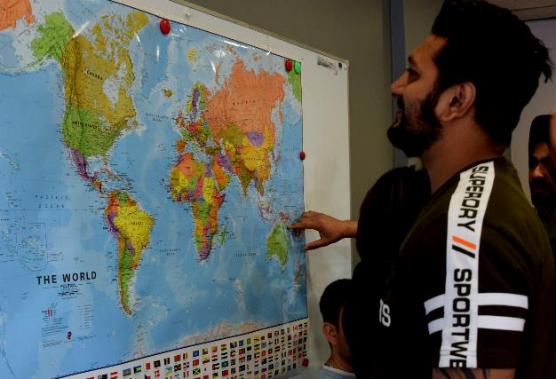

Slide 9
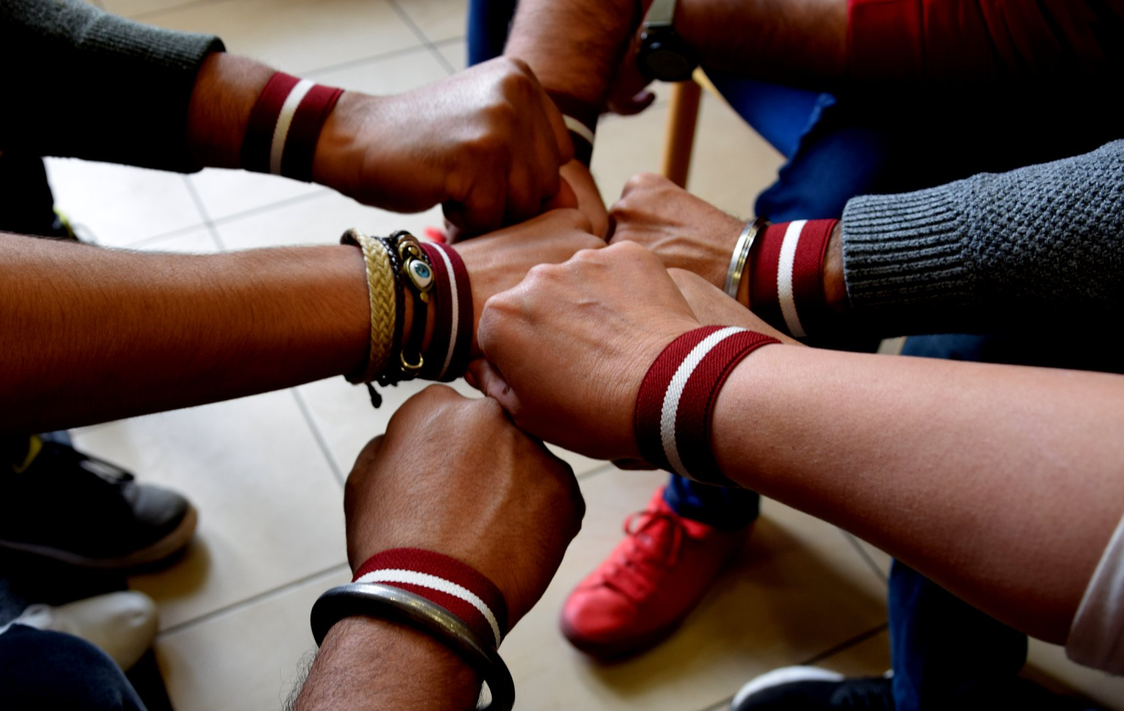

Slide 10
!
INFORMATION CENTRE FOR NEWCOMERS
in numbers from 2016 to 2021
5327
9139
10000+
30+
150+
Unique clients
Consultations about different topics
Translations done
Trainings organized
Integrations activities
Notes:
5127 unique clients – male 3287, female 1840

Slide 11
Integration: SAPUIP, Integration ABC Latvian language: Conversational club Business: Migrant Talent Garden, HERE
Related projects
!

Slide 12
!
USEFUL LINKS
https://www.integration.lv/
https://patverums-dm.lv/
Podkāsti: https://www.integration.lv/lv/podkasts
ICI ziņas: https://www.integration.lv/lv/ici-zinas
Patvērums “Drošā Māja”
Integration.lv

Slide 13
THANK YOU
Neal Creative | click & Learn more

